Slide 1
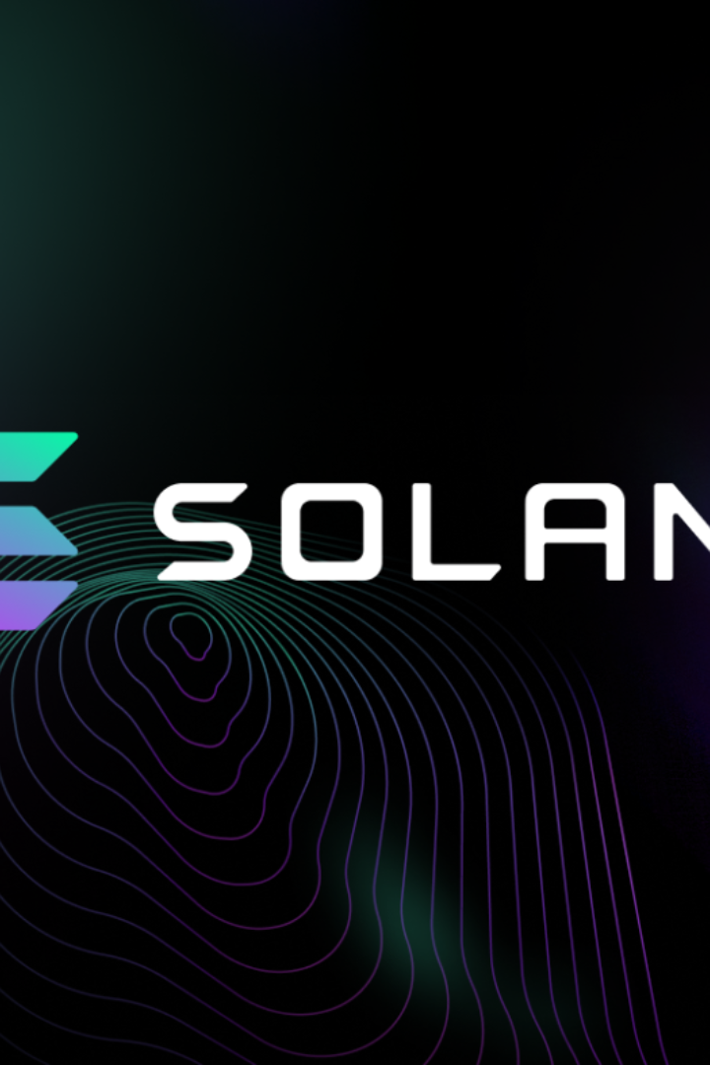

Creating a Logo Design Dapp with Solana
Welcome to this presentation on creating a logo design decentralized application (Dapp) using Solana technology. Join us on this exciting journey!
wX
by wang Xing

Slide 2

Introduction to Solana Technology
Discover the powerful features of Solana, a high-performance blockchain platform known for its scalability, low fees, and lightning-fast transaction speeds.

Slide 3

Overview of Logo Design Dapp
Learn about the logo design Dapp we're building, offering users a seamless and decentralized platform to create stunning logos for their businesses.

Slide 4
Competitive Analysis
Existing Dapps
Market Trends
User Feedback
Explore the current landscape of logo design Dapps and analyze their strengths and weaknesses to identify opportunities for improvement.
Stay ahead of the curve by understanding the latest market trends and incorporating them into our logo design Dapp.
Listen to the voice of the users and gain insights from their experiences with existing logo design Dapps to enhance our offering.

Slide 5

User Requirement
1
Intuitive Interface
2
Variety of Customization Options
3
Collaboration Features
Create a user-friendly interface that simplifies the logo design process and caters to users of all skill levels.
Implement collaborative features, allowing users to work together on logo designs and share feedback in real-time.
Offer a wide range of customization options, including fonts, colors, symbols, and layouts, to empower users to create unique logos.

Slide 6
Technical Proposal
1
Smart Contract Development
Create and deploy smart contracts on the Solana blockchain to handle logo design transactions securely.
Frontend Implementation
2
Build a responsive and visually appealing frontend interface for the logo design Dapp, ensuring a smooth user experience.
3
Integration with Design Tools
Integrate popular design tools, such as Adobe Creative Suite or Sketch, to provide advanced design capabilities to users.

Slide 7
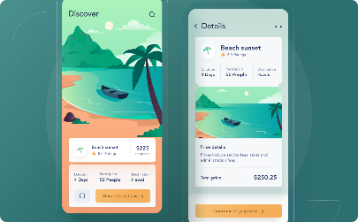
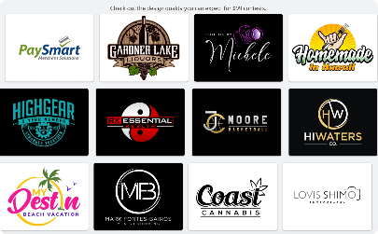

User Interface Design
Minimalistic and Intuitive
Customization Galore
Collaborative Features
Provide users with an extensive array of customization options to bring their unique visions to life.
Enable real-time collaboration among users, fostering creativity and teamwork in the logo design process.
Create a sleek and user-friendly interface, allowing users to effortlessly navigate the logo design process.

Slide 8

Backend Development
Delve into the backend development process, ensuring a secure and efficient infrastructure to support the logo design Dapp's functionality.

Slide 9

Integration with Solana Blockchain
Explore the seamless integration of the logo design Dapp with the Solana blockchain, leveraging its decentralized and transparent nature.

Slide 10

Testing and Deployment
Discuss the comprehensive testing and deployment strategies employed to ensure a stable and reliable logo design Dapp for our users.

Slide 11

Expected Result
Anticipate the positive outcomes of launching the logo design Dapp, including enhanced user experiences, increased adoption, and business growth.

Slide 12
Contract Team
Recognize the talented and dedicated team behind the logo design Dapp's development and their contributions to its success.

Slide 13

Conclusion and Future Possibilities
Wrap up the presentation by summarizing the key takeaways and discussing potential future expansions and improvements for the logo design Dapp.

